Slide 1



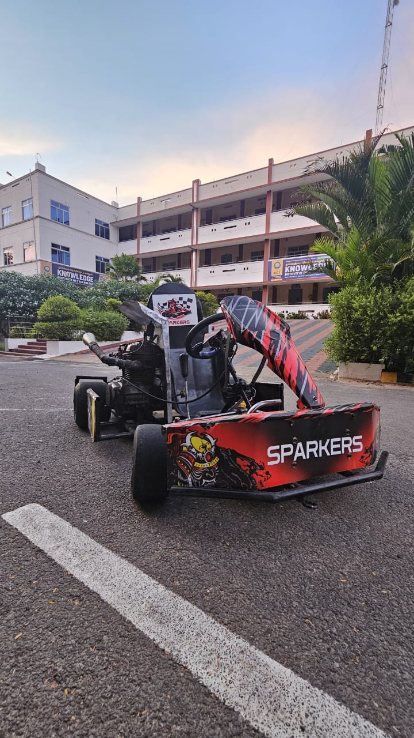

KARTING ENDURANCE CHAMPIONSHIP Organized by ACADEMY OF INDIGENOUS MOTOR SPORTS Powered By (ACADEMY OF INDIGENOUS MOTOR SPORTS,EDUCATIONAL & SOCIAL WELFARE TRUST) (Registered Trust)
COST PRESENTATION
TEAM NAME : SPARKERS
TEAM VIN NO : 25KECCV15002
COLLEGE NAME : KNOWLEDGE INSTITUTE OF TECHNOLOGY
ENGINE CATEGORY : 150cc
FUEL SYSTEM : CARBURETOR
www.aimsacademys.org Season:05 AIMS/KEC

Slide 2
OVERVIEW OF KART
Here's an overview of a Go-Kart with a 149.5 CC engine, categorized by component, along with
AISI material selection : Chassis and Frame.
Main Frame: AISI 4130 Chromoly Steel (yield strength: 435 -475 MPa)
Engine and Transmission- Engine: 149.5 CC, 4-stroke, single-cylinder.
Transmission: 5-speed manual transmission.
Brakes- Front Brakes: Ventilated disc brakes with hydraulic caliper .
Tires: Racing slicks or treaded tires (depending on the application)Safety Features
Roll Cage: AISI 1020 Steel (yield strength: 280-320 MPa).
Helmet: Mandatory for driver safety.
Weight: approximately 170kg
Top Speed: approximately 70 to 80 km/h (50-75 mph),
depending on the gearing and tire selection-
Acceleration: approximately 0-60 km/h (0-37 mph) in 3-5 seconds, depending on the engine tuning and weight distribution
www.aimsacademys.org Season:05 AIMS/KEC

Slide 3
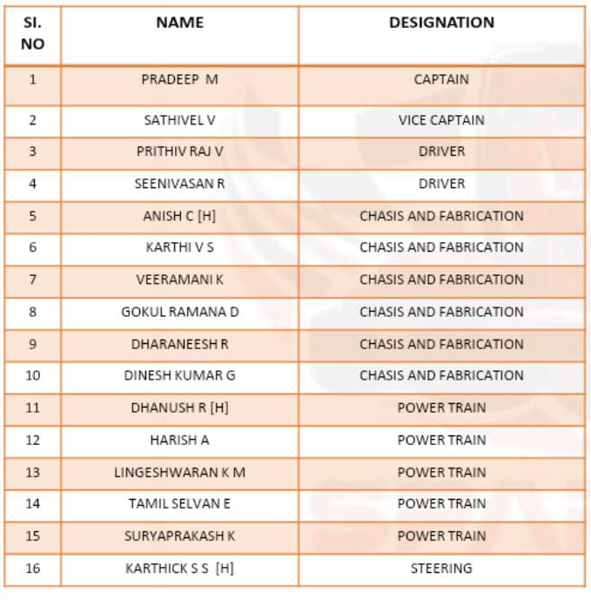
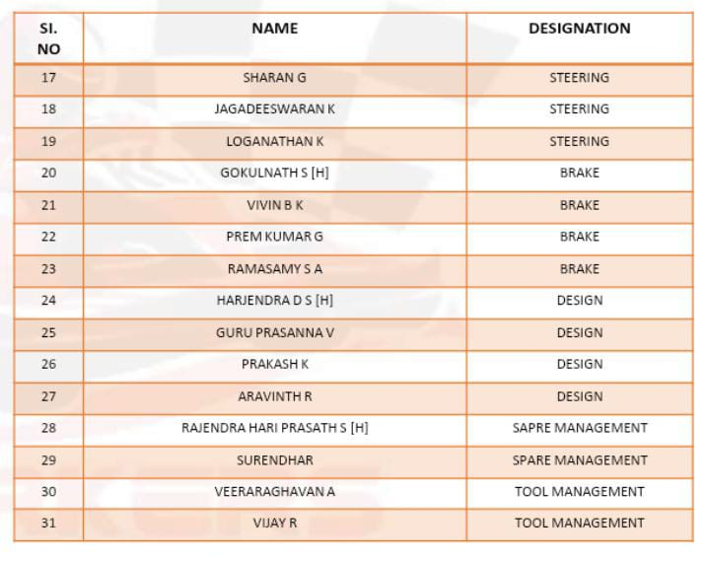
TEAM STRUCTURE
www.aimsacademys.org Season:05 AIMS/KEC

Slide 4
COST CATEGORIES
SNO | NAME OF EQUIPMENT | PRICE IN INR
1 | CHASIS | 10000
2 | ENGINE | 35000
3 | BATTERY | 1500
4 | WIRES AND EQUIPMENT | 2000
5 | TYRES | 20000
6 | BRAKES | 7500
7 | STEERING | 4000
8 | SAFTEY EQUIPMENT | 28750
9 | ELECTRICAL EQUIPMENTS | 3500
10 | OTHER EQUIPMENTS | 17900
www.aimsacademys.org Season:05 AIMS/KEC

Slide 5
ESTMATED COST
STEERING SYSTEM
ENGINE AND
TRANSIMISSON
BREAKING SYSTEM
S NO | NAME OF COMPONENT | PRICE IN INR
1 | STEERING WHEEL | 2000
2 | KNUKLE PIN | 1000
3 | TIE ROD | 1000
4 | TOTAL | 4000
S NO | NAME OF COMPONENT | PRICE IN INR
1 | MASTER CYLINDER | 1000
2 | TUBE | 700
3 | DISC | 2500
4 | CALIPER | 3500
5 | TOTAL | 7500
SNO | NAME OF COMPONENT | PRICE IN INR
1 | ENGINE | 35000
2 | SHAFT | 1000
3 | HUB | 500
4 | BEARING | 700
5 | DRIVEN GEAR | 200
6 | SHOES | 10500
www.aimsacademys.org Season:05 AIMS/KEC

Slide 6
ESTMATED COST
SAFTEY
EQUIPMENT
ELECTICAL EQUIPMENTS
OTHER COMPONENTS
S NO | NAME OF COMPONENT | PRICE IN INR
1 | SUIT | 9100
2 | HELMET | 2500
3 | GLOVES | 4900
4 | SHOES | 10500
5 | TOTAL | 28570
S NO | NAME OF COMPONENTS | PRICE IN INR
1 | BATTERY | 1750
2 | WIRES AND OTHER EQUIPMENTS | 2000
3 | TOTAL | 3500
S NO | NAME OF COMPONENTS | PRICE IN INR
1 | SEAT | 2350
2 | FARINGS | 8000
3 | FUEL TANK | 400
4 | WELDING | 2500
5 | TOTAL | 14900
www.aimsacademys.org Season:05 AIMS/KEC

Slide 7
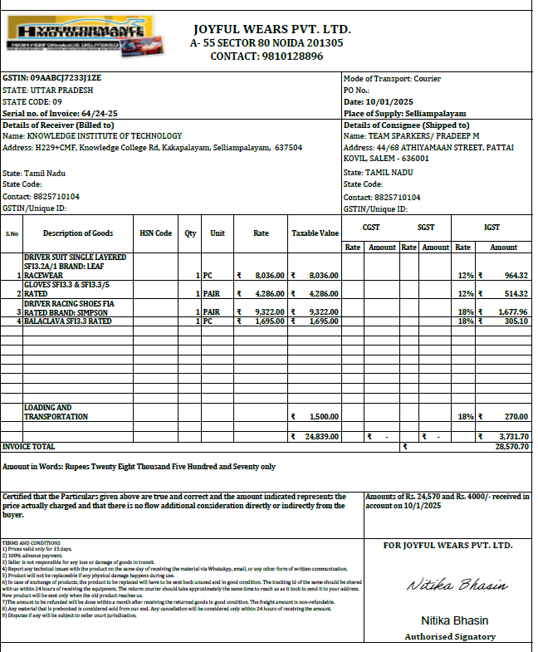
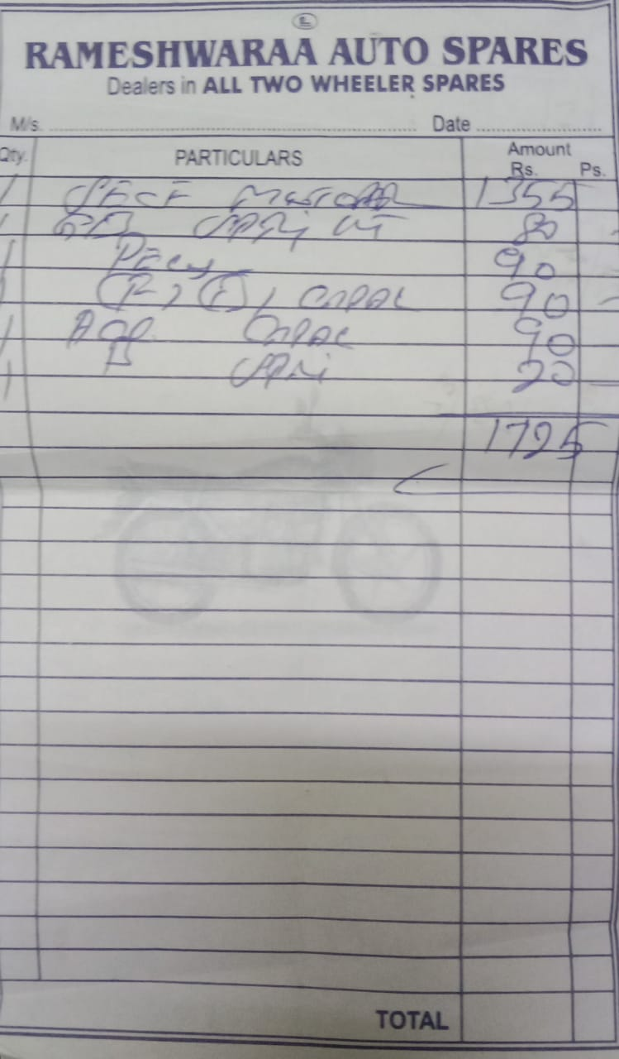
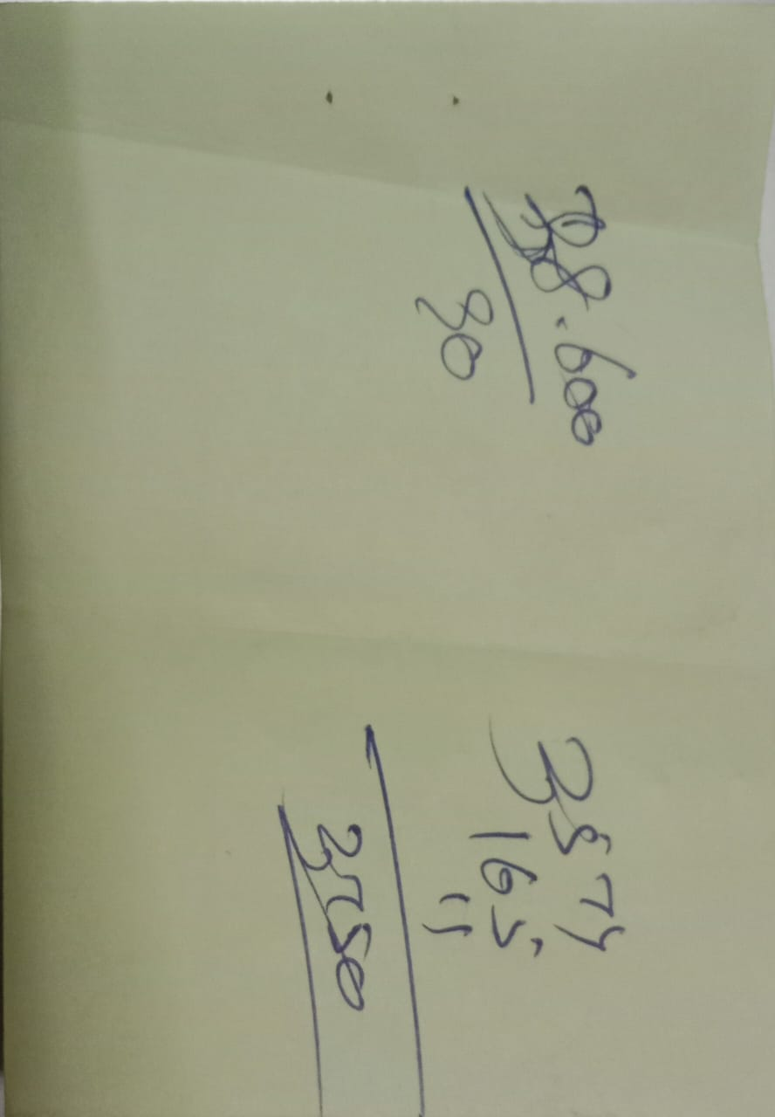
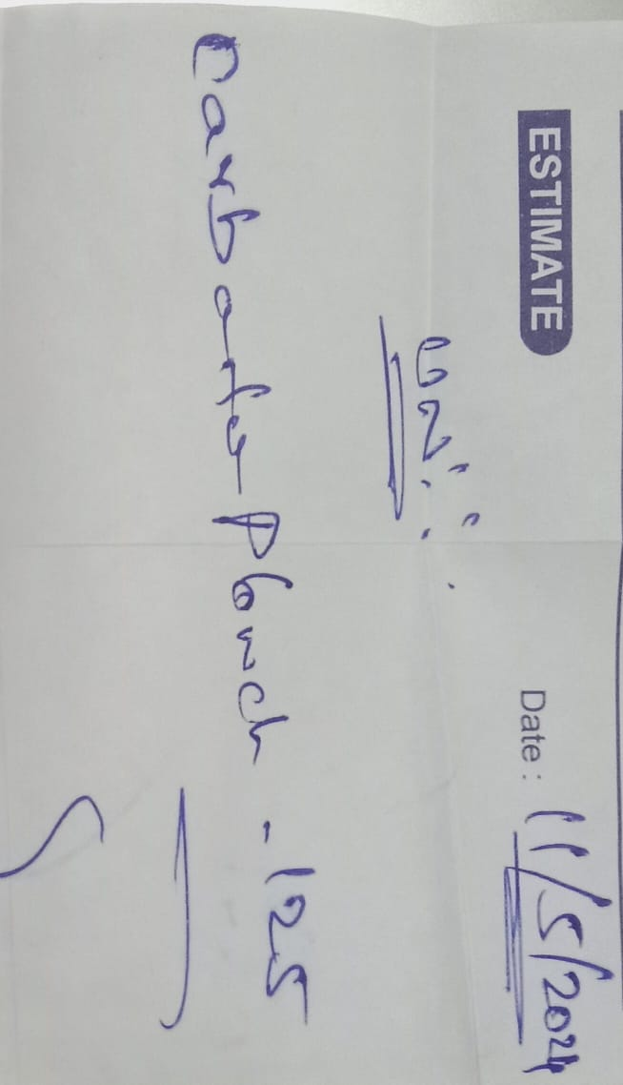
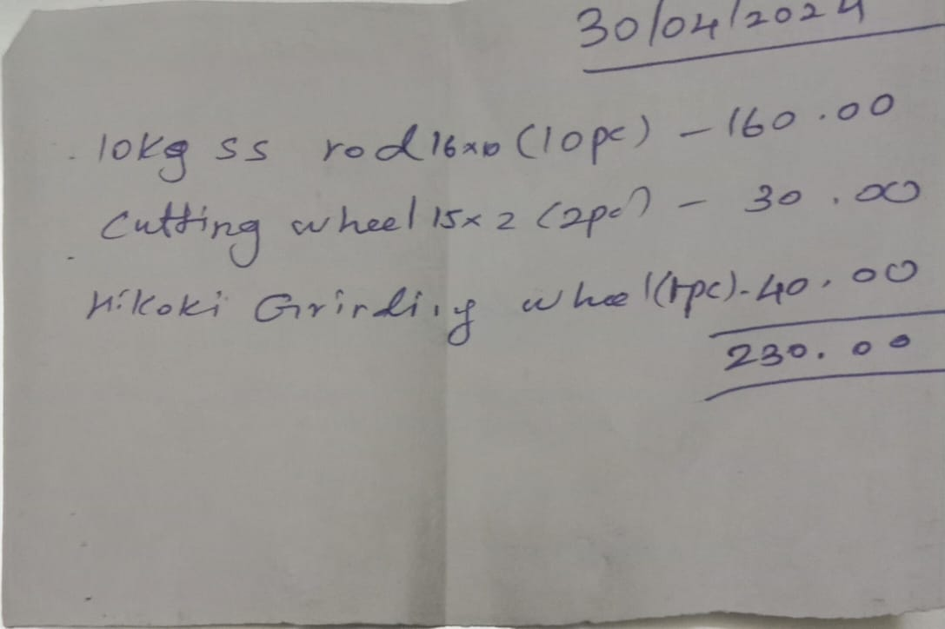
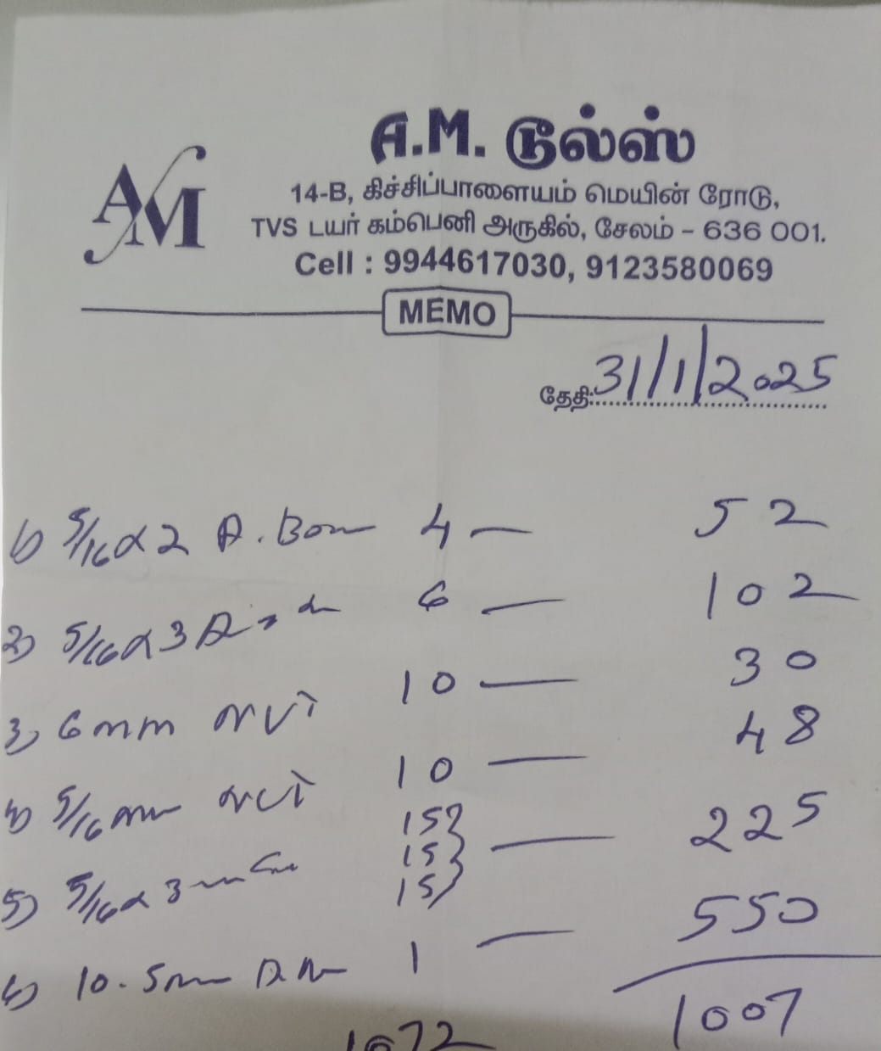
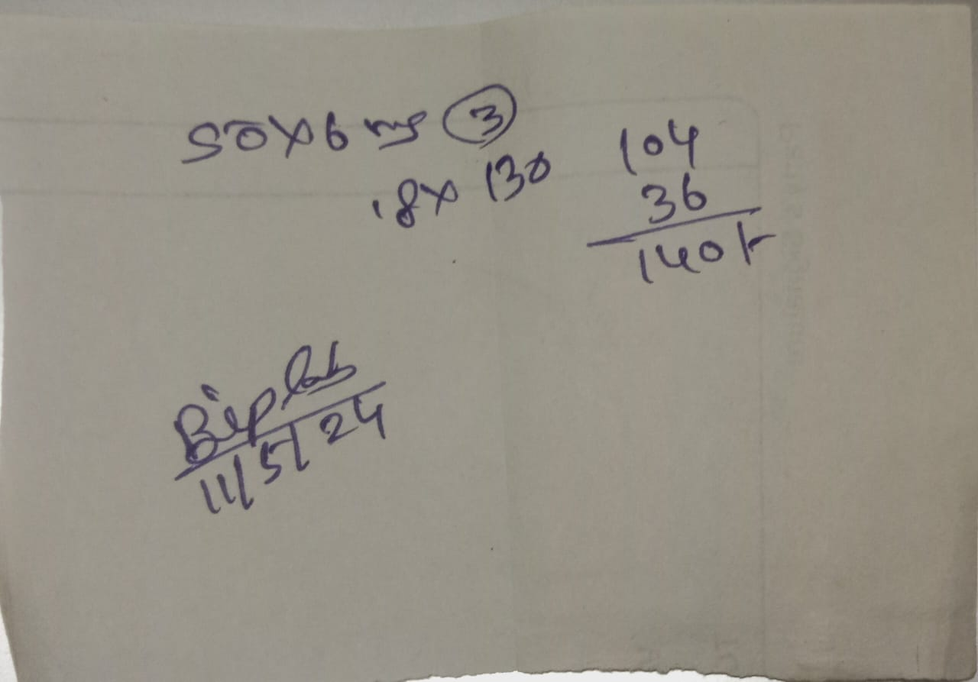
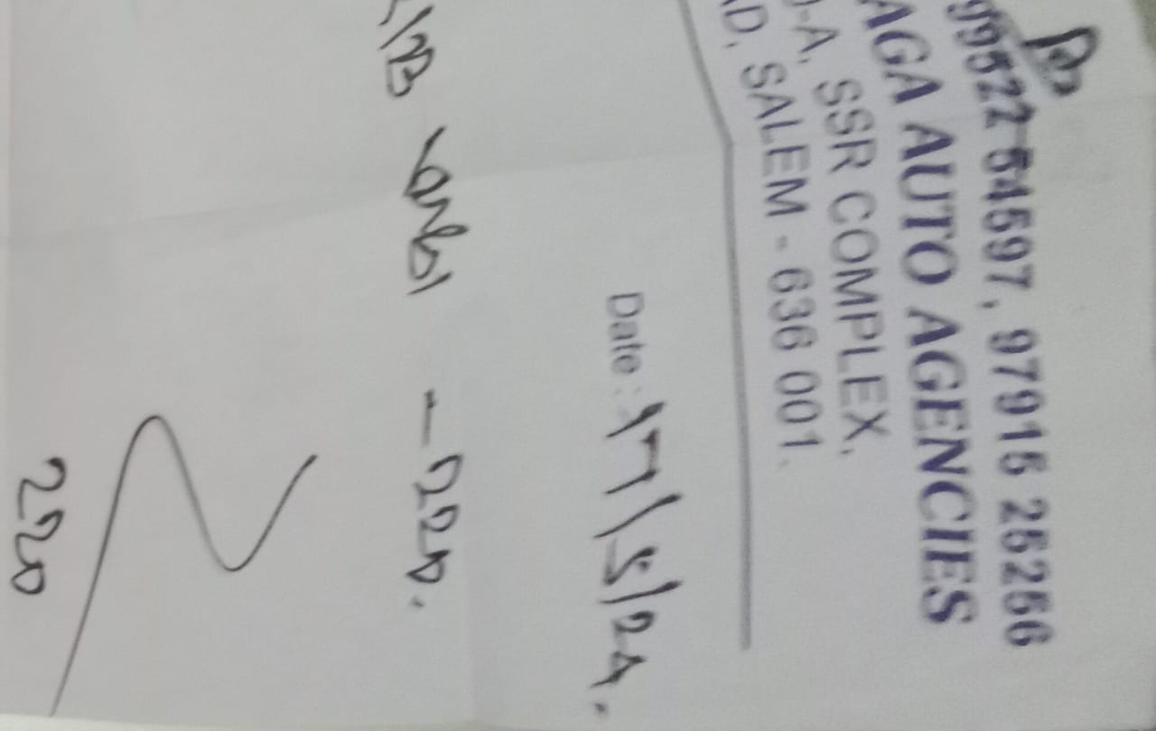
BUDGET ALLOCATION & COST MANAGEMENT
TOTAL VECHILE COST : 130150
www.aimsacademys.org Season:05 AIMS/KEC

Slide 8

THANK YOU
www.aimsacademys.org Season:05 AIMS/KEC

